Slide 1
TEXT CLASSIFICATION USING NAÏVE BAYES
Presented by:
Krishna Gopal Gowami

Slide 2
About DataSet
Data Source: Kaggle
https://www.kaggle.com/nicapotato/womens-ecommerce-clothing-reviews
Abstract: It is a Women’s Clothing E-Commerce dataset revolving around the reviews written by customers. Its nine supportive features offer a great environment to parse out the text through its multiple dimensions. Because this is real commercial data, it has been anonymized, and references to the company in the review text and body have been replaced with “retailer”.

Slide 3
About DataSet(Contd.)
This dataset includes 23486 rows and 10 feature variables. Each row corresponds to a customer review, and includes the variables:
Clothing ID: Integer Categorical variable that refers to the specific piece being reviewed.
Age: Positive Integer variable of the reviewers age.
Title: String variable for the title of the review.
Review Text: String variable for the review body.
Rating: Positive Ordinal Integer variable for the product score granted by the customer from 1 Worst, to 5 Best.
Recommended IND: Binary variable stating where the customer recommends the product where 1 is recommended, 0 is not recommended.
Positive Feedback Count: Positive Integer documenting the number of other customers who found this review positive.
Division Name: Categorical name of the product high level division.
Department Name: Categorical name of the product department name.
Class Name: Categorical name of the product class name.

Slide 4
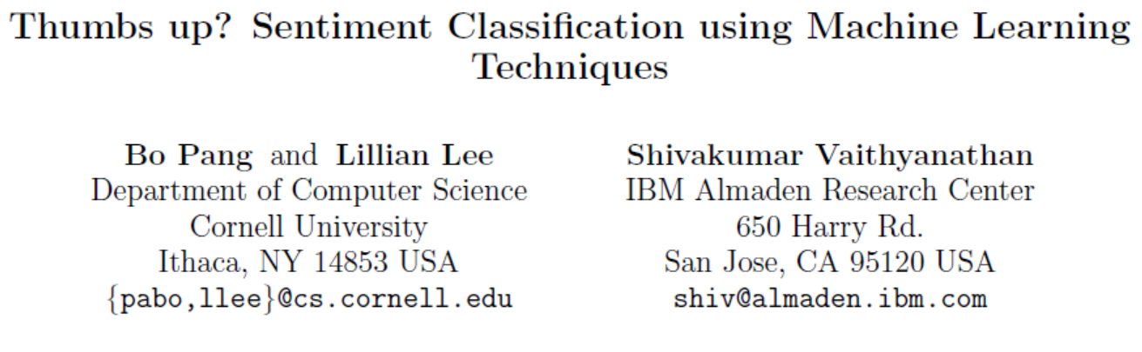
Objective
The objective of this assignment is to build a Lexicon and Naïve Bayes classifier to the customer review datasets
This project is reference to the following article:

Slide 5
Data Pipeline
Read Dataset
Explore
Head
Tail
Describe
Pre-process
Label encoding
Train and Test data preparation
Modelling
Lexican Based/Naïve Bayes classifier
Scoring
Score the test data
Diagnostics
Accuracy
AUC
Confusion Matrix

Slide 6
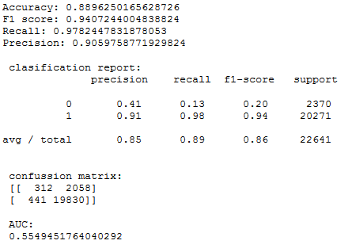
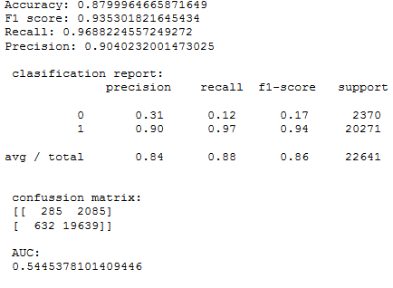
Affine based Lexican Model
Model Statistics after removing Stop Words and Punctuation
Model Statistics without removing Stop Words and Punctuation

Slide 7
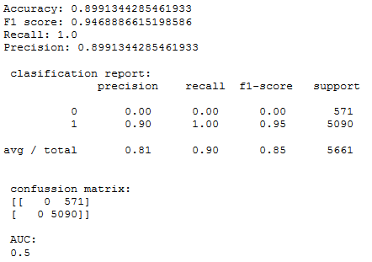
Naïve Bayes Classifier
Model Statistics after removing Stop Words

Slide 8
GitHub Link
The python code is available in the below link:
https://github.com/kgopal1982/Analytics/blob/master/TextAnalytics/ECommerceReviewAnalysis_Final.ipynb
File is also attached below for reference:

Slide 9
THANK YOU

